Slide 1
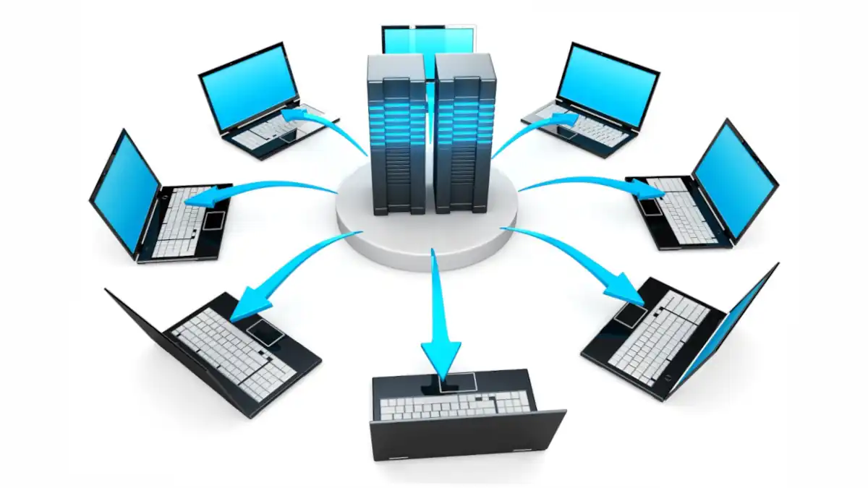
Computer Networks

Slide 2
Computer Networks and Networking
A computer network is a system that connects two or more computing devices for transmitting and sharing information. The devices can be connected using physical wires such as fiber optics or wireless media.
Computer networking is the branch of computer science that deals with the ideation, architecture, creation, maintenance, and security of computer networks.

Slide 3
Networks Protocols
Network Protocols: Network protocols are a set of established rules that determine how data is transmitted between different devices in the same network. Network protocols can be categorized into three broad categories:
Network communication protocols
Network management protocols
Network security protocols

Slide 4
Network communication protocols
Network communication protocols are a set of rules and conventions that define how data is transmitted and received over a network. These protocols ensure that devices on a network can communicate effectively by providing a standardized method for data exchange.
Hyper-Text Transfer Protocol (HTTP): Allows communication between a server and a client.
Transmission Control Protocol (TCP): A reliable, connection-oriented protocol for the sequential transmission of data packets.
Internet Protocol (IP): Facilitates routing data packets across networks.

Slide 5
Network communication protocols cont.
User Datagram Protocol (UDP): A connectionless protocol that does not guarantee the delivery of packets.
Address Resolution Protocol (ARP): Resolves an IP address to a physical address.
Simple Mail Transfer Protocol.

Slide 6
Network management protocols
Network management protocols are specific sets of rules and conventions designed to facilitate the monitoring, control, and coordination of network devices and resources. These protocols enable administrators to manage and maintain network functionality, troubleshoot issues, and optimize performance. Here are some key network management protocols
Simple Network Management Protocol (SNMP): Helps administrators manage network devices by monitoring endpoint information
Internet Control Message Protocol (ICMP): Helps diagnose network connectivity issues

Slide 7
Network security protocols
Network security protocols are essential components of cybersecurity, providing mechanisms to protect data, communication channels, and network infrastructure from various threats. These protocols help establish secure communication, authenticate users and devices, encrypt data, and ensure the integrity and confidentiality of networked systems
Secure File Transfer Protocol (SFTP): Uses encryption to secure file transfers
Secure Sockets Layer (SSL) and Hypertext Transfer Protocol Secure (HTTPS): Provide secure communication over a computer network

Slide 8
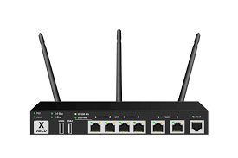
Network Devices
Network devices are physical or virtual components that play specific roles in the functioning of a computer network. These devices are responsible for facilitating communication, managing data traffic, and ensuring the smooth operation of the network. Here are some common network devices.
Router: This connects different networks and directs data traffic between them. They use routing tables to determine the optimal path for data to reach its destination.
NB: Wireless router

Slide 9
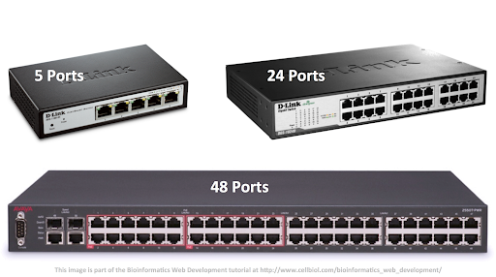
Network Devices cont.
Switch
Switches operate at the data link layer and are used to connect multiple devices within the same network (usually a local area network or LAN). They forward data based on MAC addresses.

Slide 10
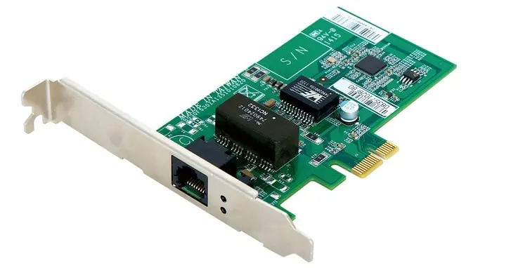
Network Devices cont.
Network Interface Card (NIC):
NICs are hardware components that enable computers and other devices to connect to a network. They provide a physical interface for the transmission and reception of data

Slide 11
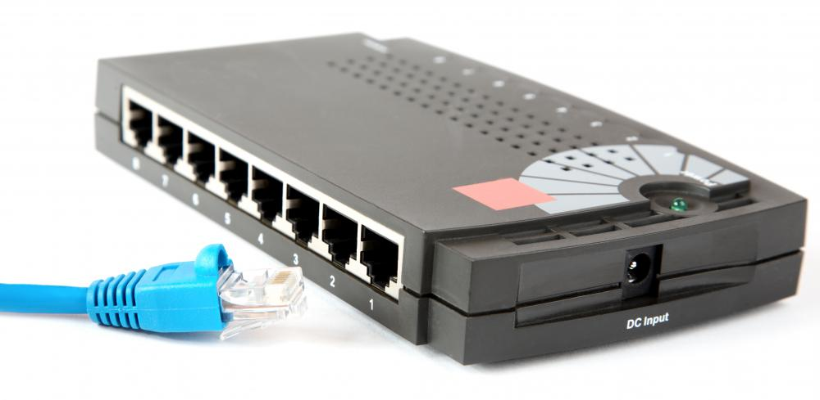
Network Devices cont.
Hub:
Hubs are basic networking devices that connect multiple devices in a LAN. Unlike switches, hubs do not intelligently manage data traffic and broadcast data to all connected devices.

Slide 12
Network Topologies
Network topology refers to the physical or logical layout of a computer network, including the arrangement of nodes (devices) and the connections between them.

Slide 13
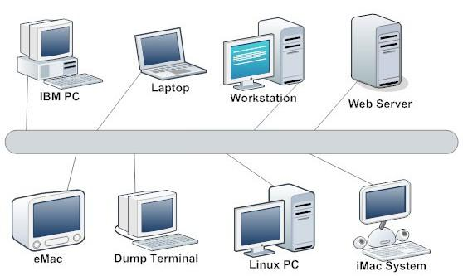
Bus Topology
In a bus topology, all devices share a single communication line or bus. Data is transmitted along the bus, and each device receives the data but only processes information intended for it.
Advantages: Simple to implement and cost-effective.
Disadvantages: Performance can degrade as more devices are added, and a single point of failure exists.

Slide 14
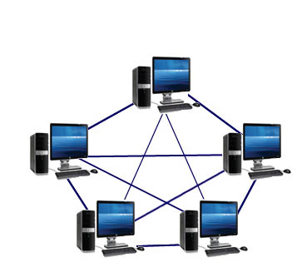
Mesh Topology
Every device is connected to every other device, creating a fully interconnected network. Mesh topologies can be either full mesh (every device is connected to every other) or partial mesh (some devices have limited connections).
Advantages: High redundancy and fault tolerance, direct communication paths.
Disadvantages: Complex and expensive to implement, extensive cabling.

Slide 15
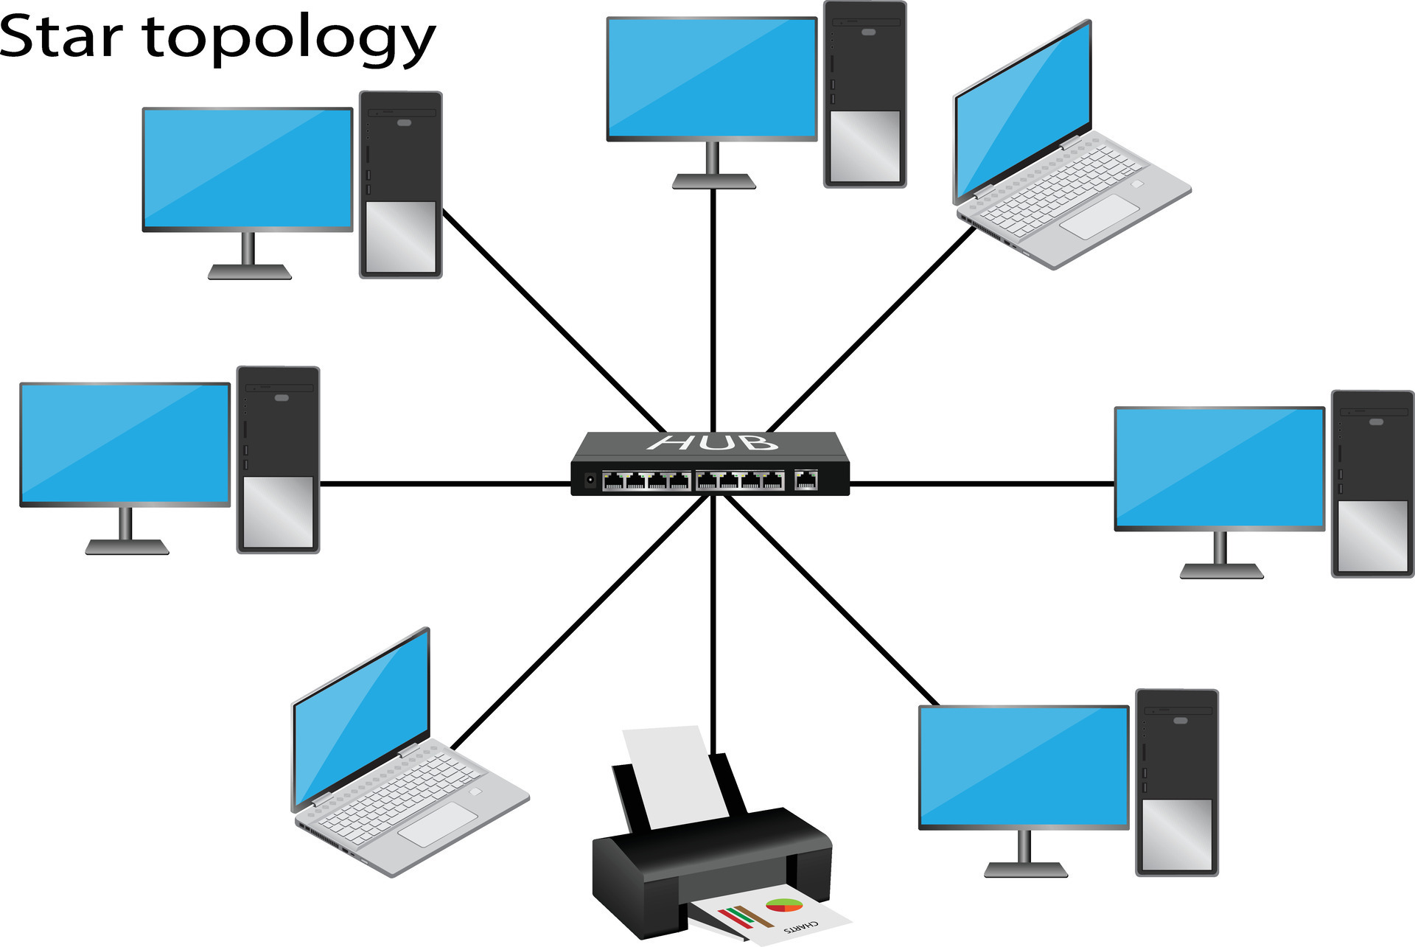
Star Topology
In this topology all devices are connected to a central hub or switch, forming a star-shaped configuration. Communication occurs through the central hub.
Advantages: Easy to install, centralized management and a failure in one connection does not affect other devices.
Disadvantages: Dependence on the central hub; if it fails, the entire network may be affected.

Slide 16
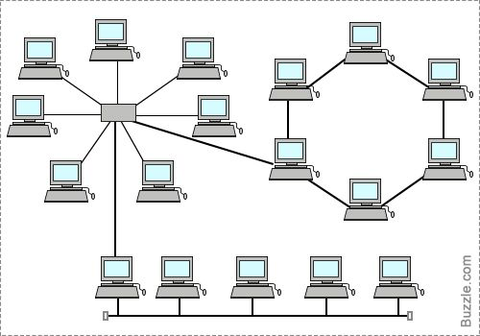
Hybrid Topology
This topology combines two or more different topologies to form a single network. For example, a combination of star and ring topologies.
Advantages: Offers flexibility and can be tailored to specific needs.
Disadvantages: Complexity and potential for higher costs.

Slide 17
Types of computer networks
Local Area Networks (LANs)
Wide Area Networks (WANs)
Metropolitan Area Networks (MANs)
Person Area Network (PAN)

Slide 18
Local Area Networks (LANs)
A Local Area Network (LAN) is a computer network that interconnects computers and other electronic devices within a limited area, such as a residence, school, laboratory, university campus, or office building.
The devices within a LAN can range from a small number to thousands of devices, and they can include personal computers, access points, routers, switches, and other network devices.

Slide 19
Wide Area Networks (WANs)
A Wide Area Network (WAN) is a telecommunications network that extends over a large geographic area and connects devices from multiple networks.
WANs can facilitate communication and data sharing across long distances. The internet is the largest WAN globally.

Slide 20
Metropolitan Area Networks (MANs)
A Metropolitan Area Network (MAN) is a computer network that connects computers within a metropolitan area, which could be a single large city, multiple cities and towns, or any given large area with multiple buildings. MAN is larger than LAN but smaller than WAN. The size of MANs usually ranges from 5 kilometers to 50 kilometers.

Slide 21
Personal Area Networks (PANs)
PAN is a network that is used by devices within a specific geographic area, such as a home, office, or campus. Typically, around 10 meters.

Slide 22
Importance of computer network.
Access to Information: Computer networks provide access to information and data, which is essential for businesses and individuals.
Resource Sharing: Networks allow for the sharing of resources such as printers, files, and data storage, leading to increased efficiency and cost-effectiveness.
Collaboration and Communication: They enhance collaboration by enabling easy data sharing and communication through email, instant messaging, and video conferencing.
Business Growth and Flexibility: The right networking solution can help businesses grow and evolve by allowing staff to share information effortlessly, increasing productivity and efficiency.

Slide 23
Importance of computer network.
Information Interchange: Computer networking has become a critical means of information interchange between people, forming the foundation of good communication.
Conducting Research: Networks connect individuals to internal resources and the internet, enabling them to conduct research and access new information.
Streamlining Operations: Computer networks optimize convenience, flexibility, and the exchange of ideas, streamlining business operations.

Slide 24
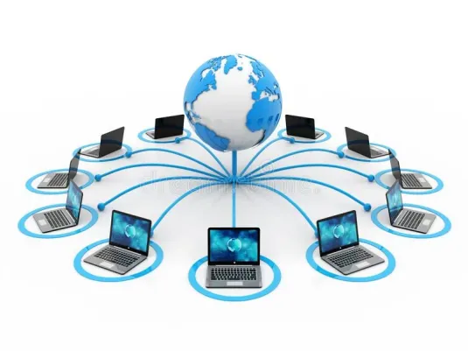
The Internet.
The Internet is a global system of interconnected computer networks that allows for the transmission of data and communication between devices worldwide. It is a public, cooperative, and self-sustaining facility that has become the primary source of information consumption for millions of people.
The Internet is a network of networks that uses the Internet protocol suite (TCP/IP) to communicate between devices.

Slide 25
Importance of the internet.
Communication and Information Access: The Internet enables easy and inexpensive communication between people worldwide, allowing them to explore and share ideas, maintain social connections, and access information.
Education: Online distance learning courses, online books, and tutorials provide access to education for people regardless of their location.
Economic Development: The Internet facilitates online job searches, digital transactions, and e-commerce, contributing to economic growth.

Slide 26
Importance of the internet cont.
Research and Development: The internet is a valuable resource for research and development, as it provides access to a wealth of information and allows businesses to stay competitive.
Digital Transactions: The internet enables digital transactions, such as internet banking, mobile banking, and e-wallets, making life more convenient and efficient

Slide 27
Disadvantages of the internet.
Identity theft and hacking: The internet is vulnerable to hacking and identity theft, which can have severe financial and personal consequences for users.
Cyberbreaches: The risk of cyberbreaches is a significant disadvantage of the internet, as websites, applications, emails, and software can be prone to breaches.
Bullying, trolls, and stalkers: The anonymity of the internet can enable trolls, bullies, and stalkers to target victims without facing immediate consequences.

Slide 28

World Wide Web (WWW)
The World Wide Web (WWW) is an information system that enables content sharing over the Internet. The Web was invented by English computer scientist Tim Berners-Lee while at CERN in 1989 and opened.

Slide 29
Differences between Internet and WWW
INTERNET | WWW
It is a global network of interconnected computer networks that uses a suite of protocols to transmit data and facilitate communication between devices. | The World Wide Web is a system for making information available to users through the internet.
It serves as the underlying infrastructure that supports various online services and applications, including the World Wide Web. | The World Wide Web is one of the applications built on the Internet and is the most common way users access and share information online.
It is a collections of network devices such as computers, routers, cables etc. | It is a collection of information and web pages that can be accessed using the Hypertext Transfer Protocol (HTTP).

Slide 30
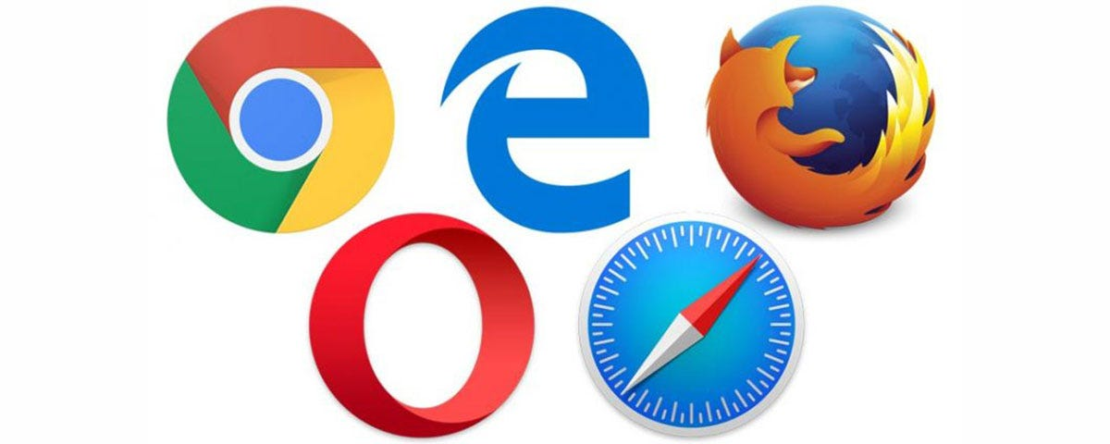
Web Browsers
Web browsers are applications used to access websites and the internet. They allow users to view text, images, and videos from anywhere in the world.
Web browsers are available for various devices, including desktops, laptops, tablets, and smartphones. Some of the most popular web browsers include Google Chrome, Mozilla Firefox, Apple Safari.

Slide 31
Features of web browsers
Displaying web pages: When a user requests a web page from a particular website, the browser retrieves its files from a web server and then displays the page on the user's screen.
Extensions and customization: Web browsers can be customized using extensions, which add additional features and functionality to the browser.
Compatibility: Web browsers should be compatible with a wide range of websites and web applications, ensuring that users can access the content they want.
Security: Browsers should prioritize security, protecting users from trackers, hackers, and internet eavesdroppers.

Slide 32
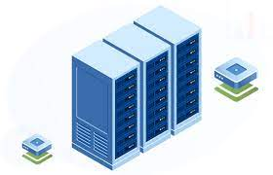
Servers
A server in computer networking is a computer or software program that provides resources, data, services, or programs to other computers, known as clients, over a network.
Servers can provide various functionalities, such as sharing data or resources among multiple clients, performing computations for a client, and hosting applications or websites.

Slide 33
Types of servers
Generally, speaking these are the types of servers we have:
1. File Server:
Function: Manages and provides access to files and data within a network.
Key Features: Facilitates file sharing, storage, and retrieval for users or client devices.
2. Database Server:
Function: Manages databases and provides access to stored data.
Key Features: Handles database queries, updates, and transactions for applications or users.

Slide 34
Types of servers cont.
3. Application Server:
Function: Executes and manages applications, providing runtime environments for software programs.
Key Features: Supports the execution of application code, manages transactions, and facilitates communication between applications.
4. Mail Server:
Function: Manages and delivers email messages.
Key Features: Handles email storage, retrieval, and transmission between email clients.

Slide 35
Types of servers cont.
5. DNS Server (Domain Name System):
Function: Resolves domain names to IP addresses, enabling users to access websites using human-readable names.
Key Features: Translates domain names to IP addresses and vice versa, supporting the hierarchical structure of the DNS.
6. VoIP Server (Voice over Internet Protocol):
Function: Supports voice communication over the internet by managing VoIP protocols and services.
Key Features: Facilitates voice calls, video calls, and other multimedia communications.

Slide 36
Web Servers
Web servers are a type of server designed to host and deliver websites, web applications, and related content to users over the internet.
They play a crucial role in responding to requests from web browsers, processing these requests, and delivering the requested web pages to users.
Examples are Apache HTTP Server, Nginx, Microsoft Internet Information Services (IIS), and Tomcat.
Key Features: Handles HTTP requests, processes web pages, and serves content to web browsers.

Slide 37
Types of web Servers
Dedicated Server: A dedicated server is a type of hosting service where an entire physical server is allocated to a single user or organization. The user has exclusive access to all the server resources (CPU, RAM, storage, bandwidth).
Key Features:
High Performance: Dedicated servers provide robust performance as all resources are dedicated to a single user.
Full Control: Users have full administrative access to the server, allowing them to install and configure software, customize settings, and manage security.
Customization: Users can choose the hardware specifications and software configurations based on their specific needs.
Scalability: Resources can often be scaled up or down based on changing requirements

Slide 38
Types of web Servers cont.
Shared Server: In a shared server hosting environment, multiple users share the resources of a single physical server. Each user gets a portion of the server's resources, and they all use the same server for hosting their websites or applications.
Key Features:
Cost-Effective: Shared hosting is typically more affordable since the cost is divided among multiple users.
Easy Setup: Hosting providers handle server maintenance, setup, and configuration, making it easy for users who don't need to manage the server themselves.
Limited Control: Users have limited administrative control over the server as it is shared among multiple accounts.
Resource Limitations: Users are allocated a fixed number of resources (CPU, RAM, storage), and resource spikes from other users may affect performance.

Slide 39
QUESTION?

Slide 40
THANK YOU!

